Slide 1
Coursera Capstone - A Comparison of a Suburb’s Median House Price in Four Major Australian Cities
Stephen Moore

Slide 2
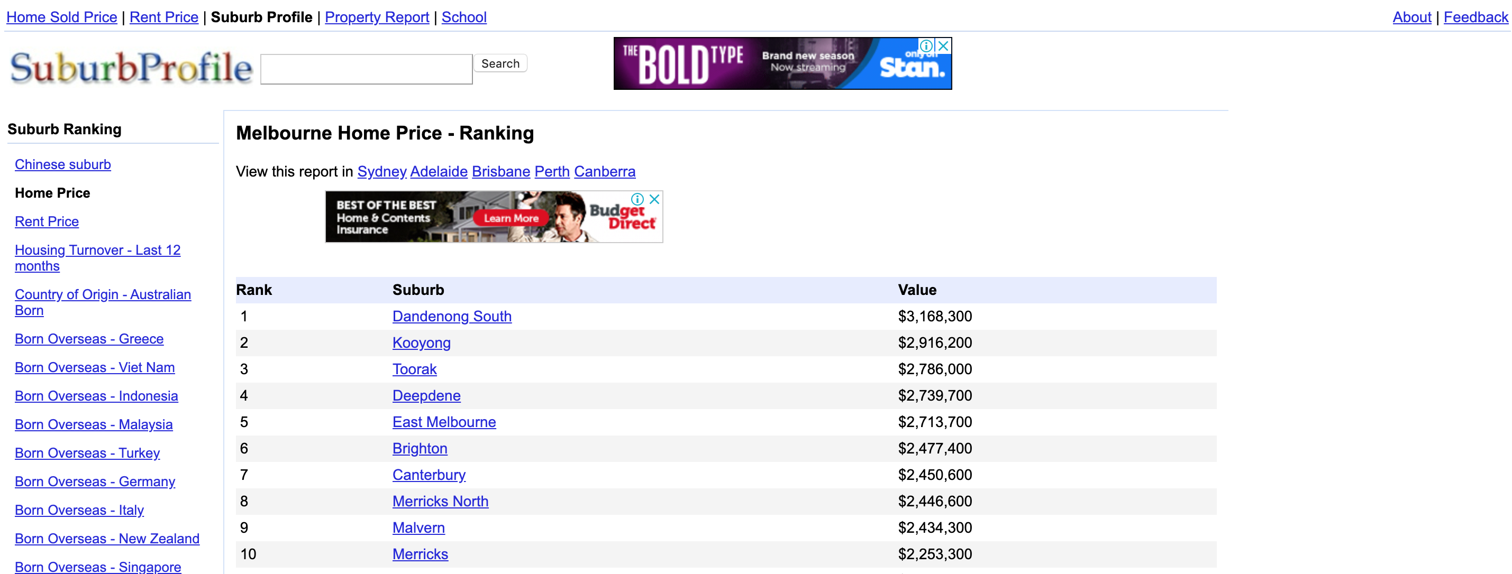
Introduction
The purpose of this assignment was to compare the median house prices of different suburbs in the Australian cities of Brisbane, Melbourne, Sydney, and Perth
The main source of data is the Suburb Profile site

Slide 3
Methodology
Beautiful Soup to scrape the websites and compile a data frame of suburbs and prices for each city
Nominatum to find the geographic coordinates of each suburb, the CBD, and then the distance to the CBD of each suburb.
Foursquare to get the categories of venues nearby each suburb
Folium to visualize cities with markers colouring the suburbs by binned price, distance to CBD, and k-means derived clusters
Second order polynomial regression as a predictor of suburb price by distance to CBD
Support vector regression as a predictor of suburb price by categories of nearby venues

Slide 4
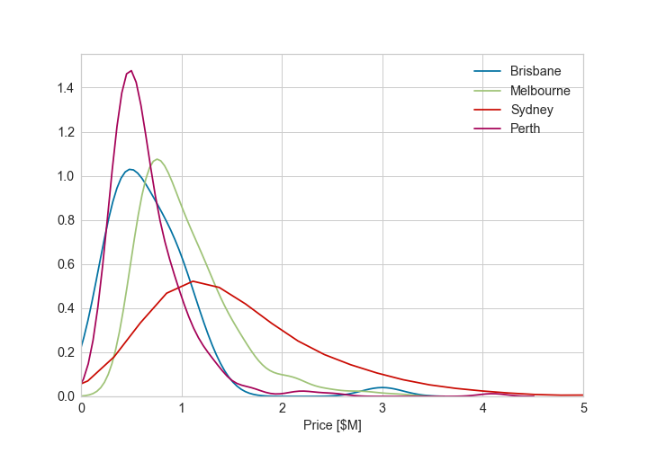
Results
Brisbane, Melbourne, and Perth have relatively tight distributions of suburb prices centered around the $0.5-0.8M mark
Sydney has a much broader distribution of prices, going right up to the $23M mark (not shown in figure)

Slide 5
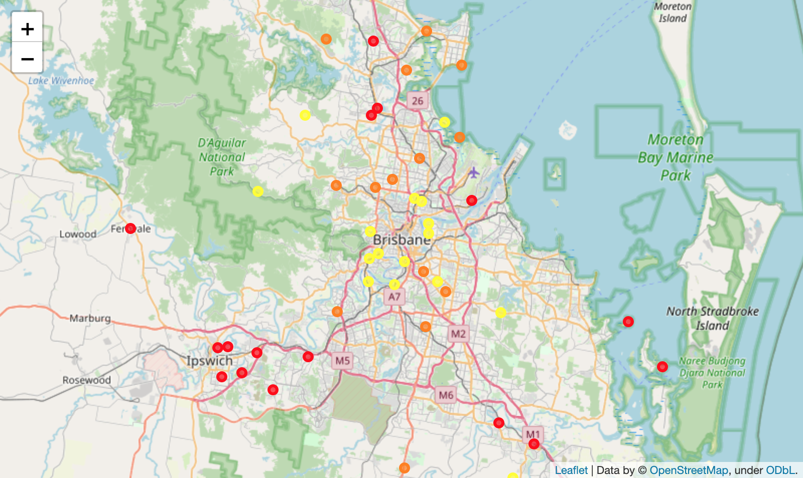
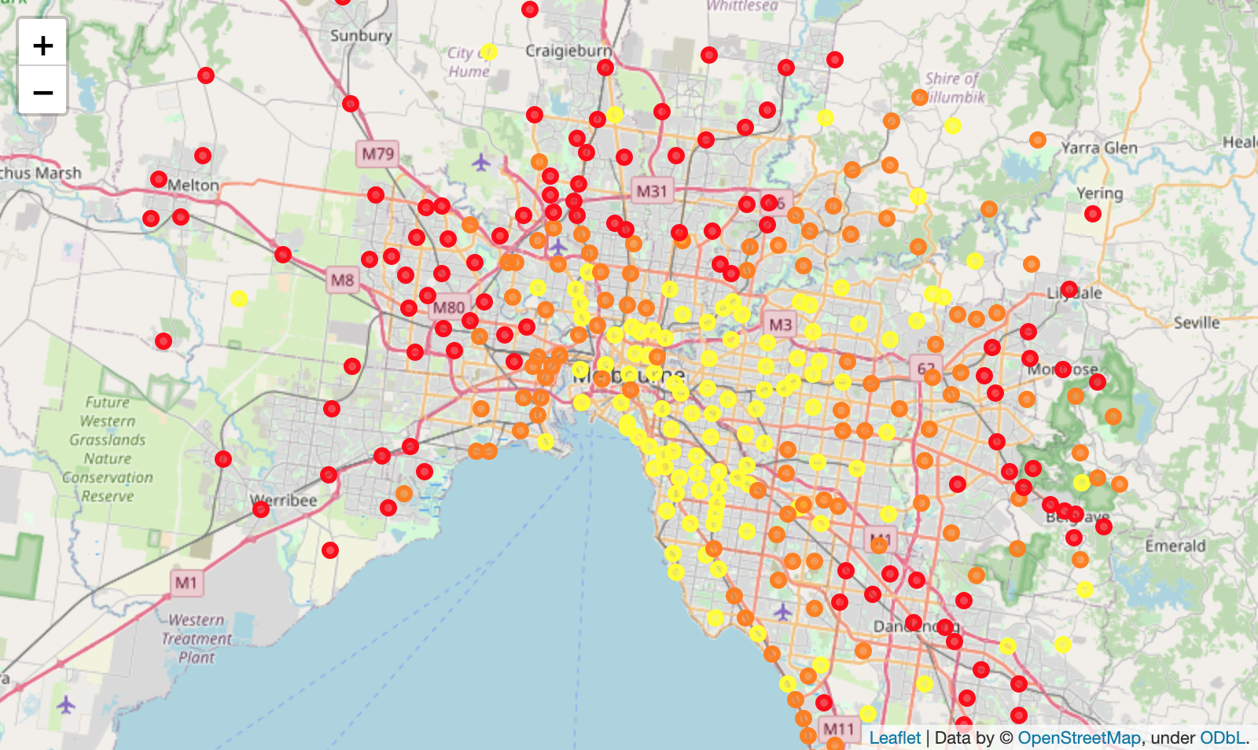
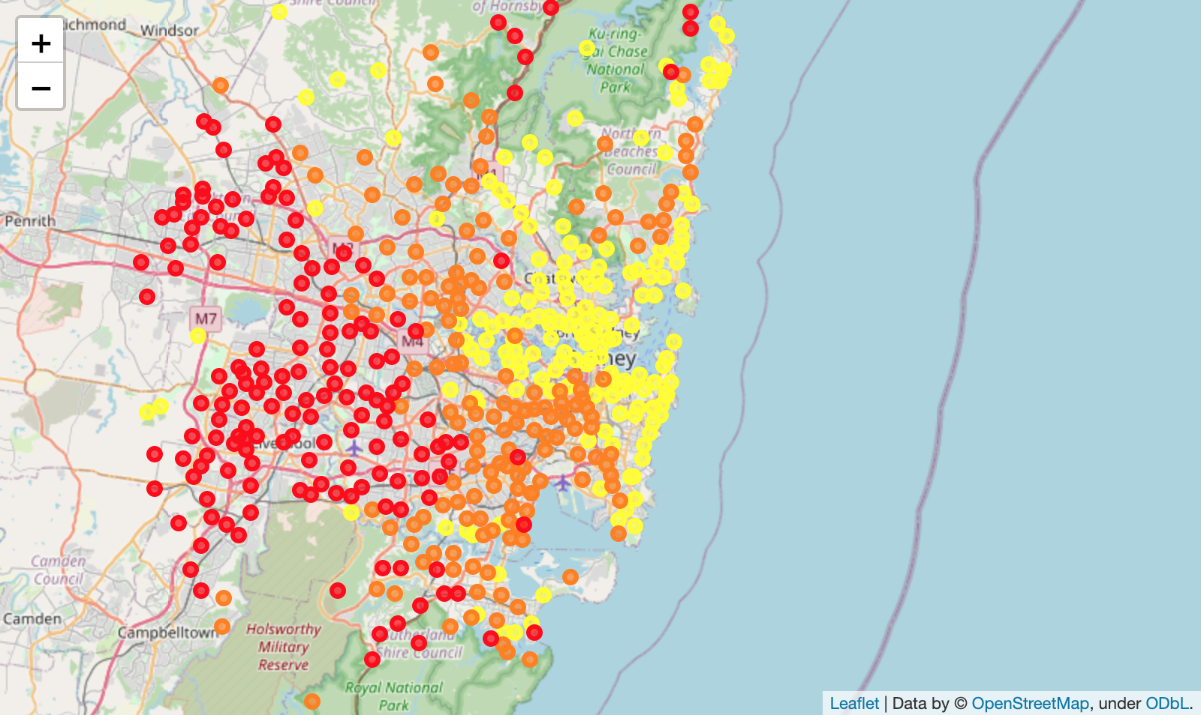
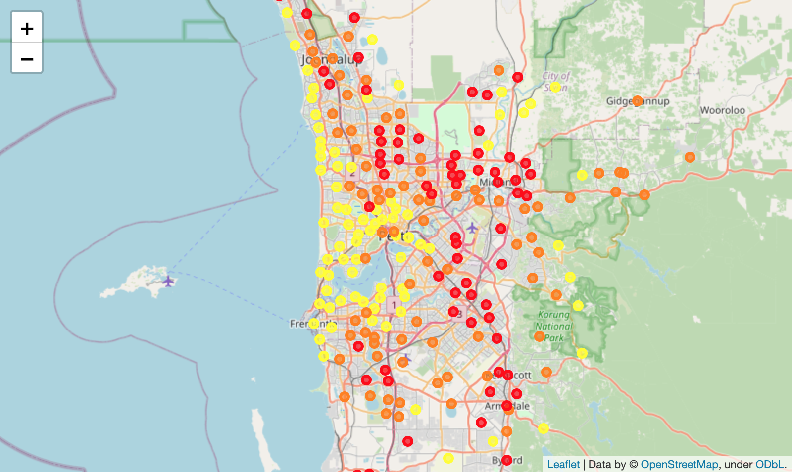
Results
Leaflet Maps of binned suburb prices
The most expensive suburbs are located close to the CBD and coastline

Slide 6
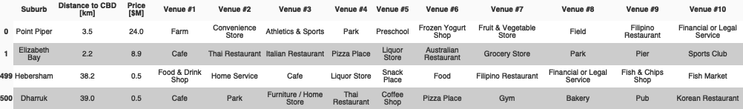
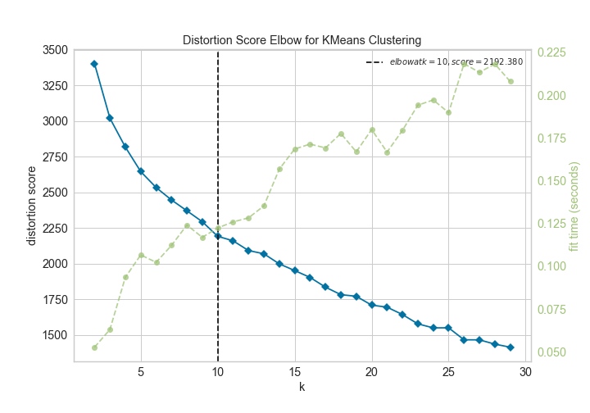
Results
The most common venues appear similar for across the most expensive and least expensive suburbs, e.g.
Use the Elbow method to determine the optimal number of clusters (ranges from 10-18)

Slide 7
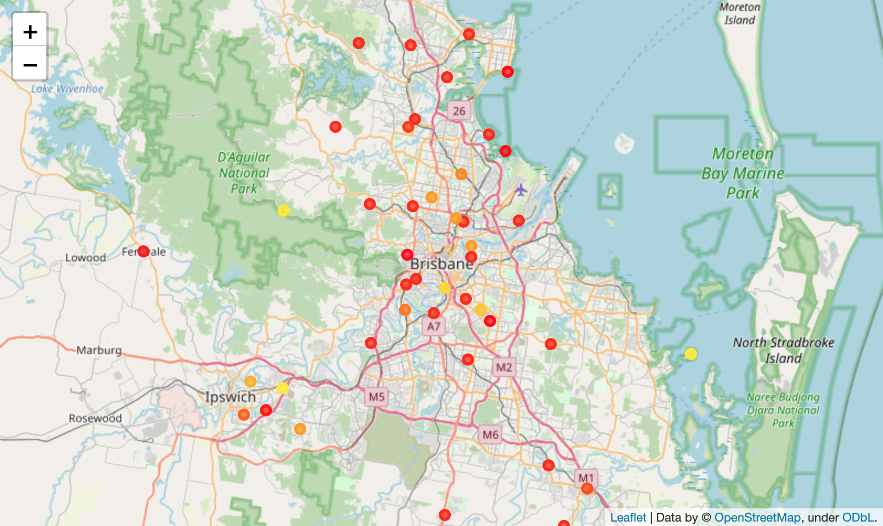
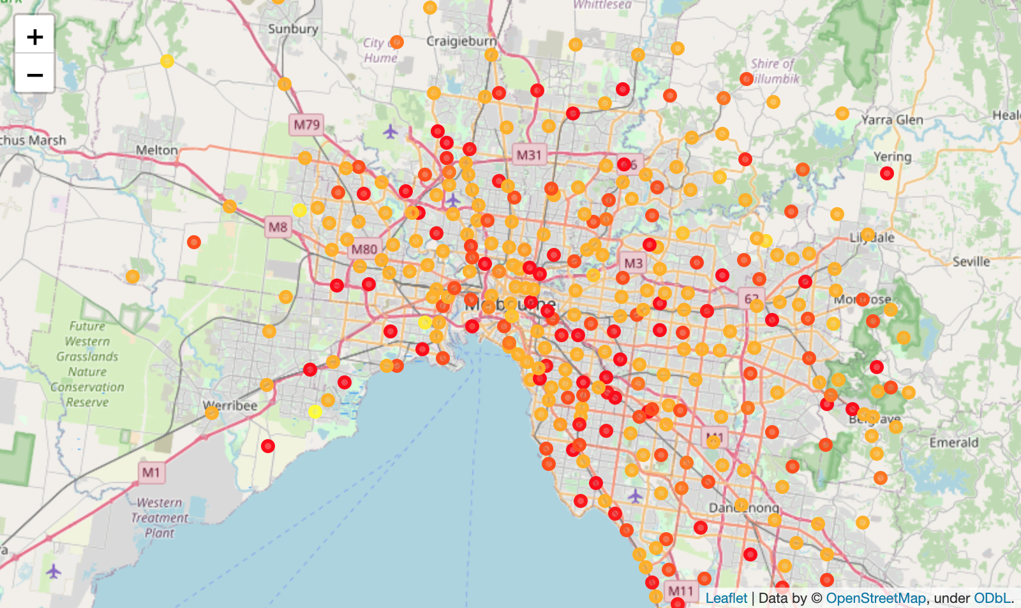
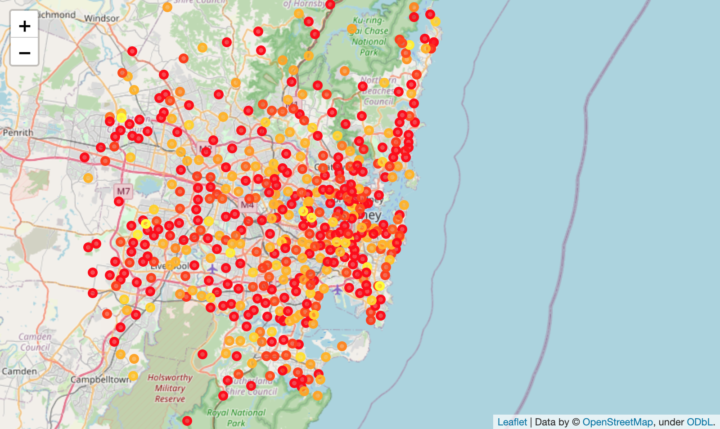
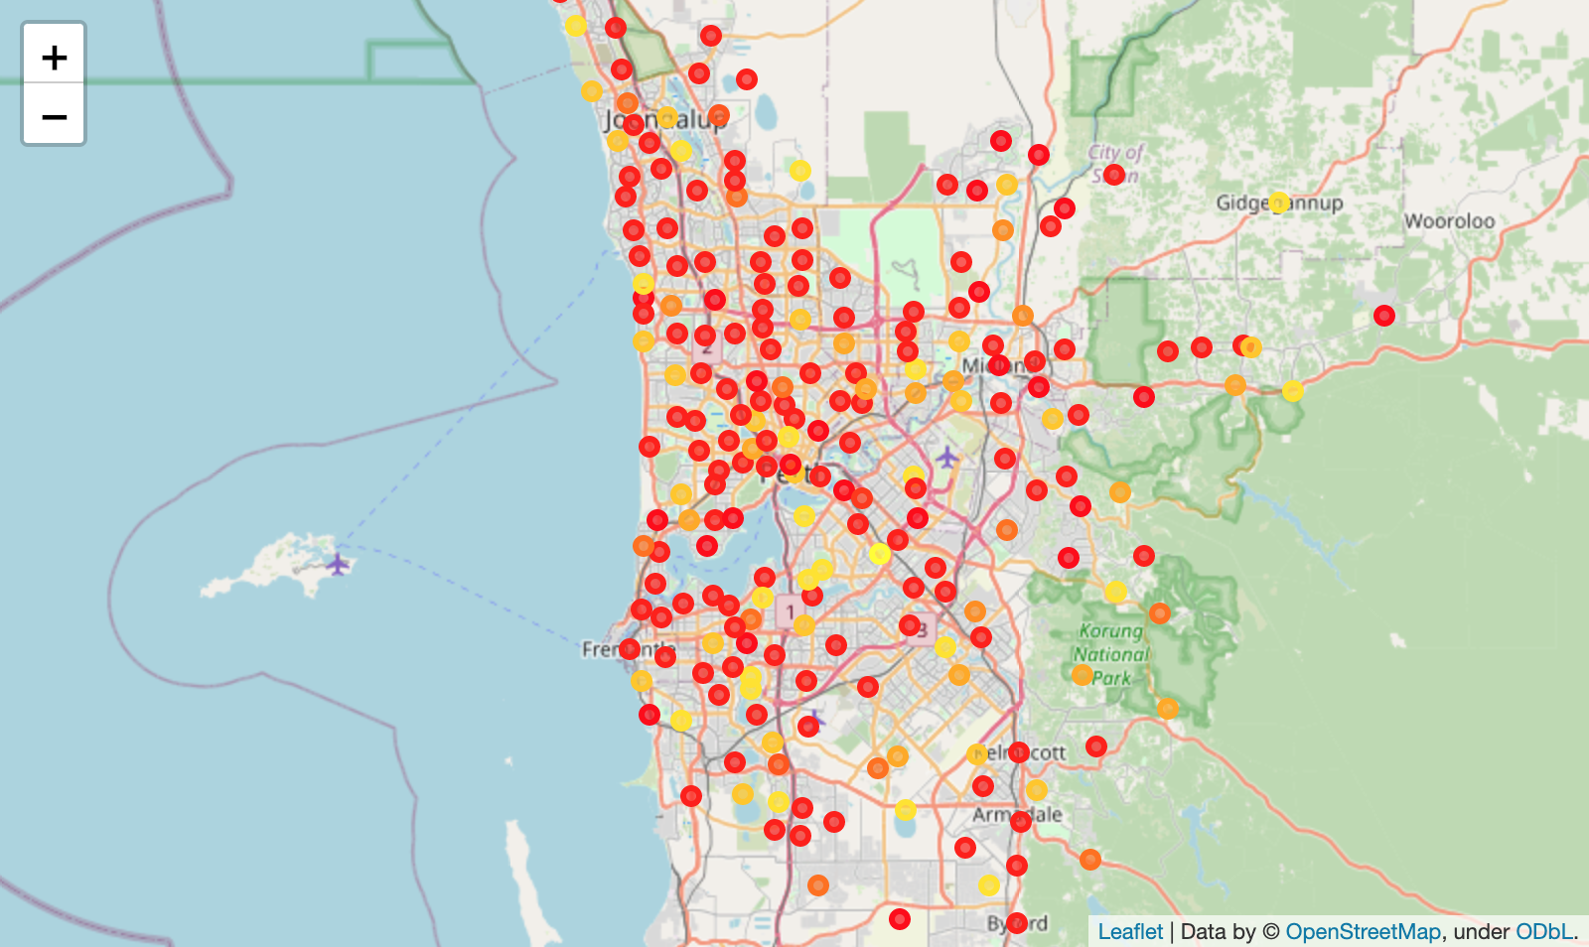
Results
Leaflet Maps of clusters
The clusters different clusters appear scattered throughout the cities

Slide 8
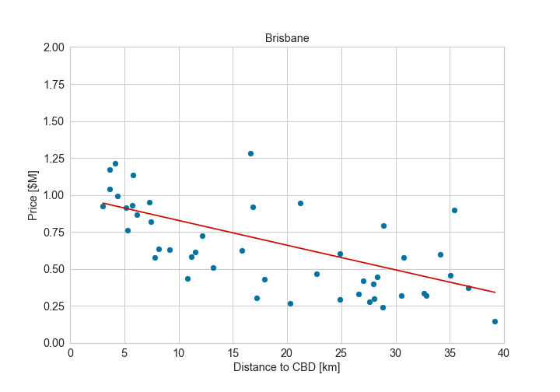
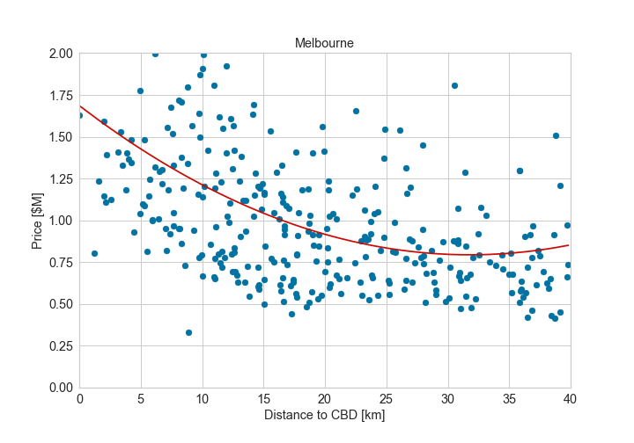
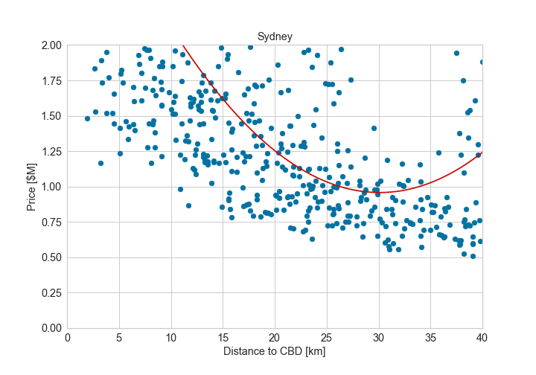
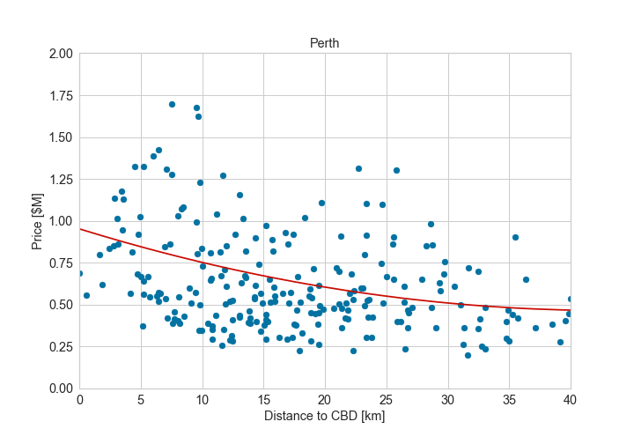
Results
Second order polynomial regression using the distance to the CBD as a feature for predicting a suburb’s median house price
In general there is a decrease in price with increasing distance from the CBD

Slide 9
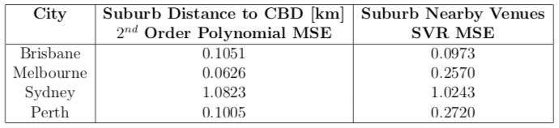
Results
Using the nearby venues with a Support Vector Regressor (SVR) tends to perform slightly worse than the polynomial regressor.
This is especially true for Melbourne, where a suburb’s median house price correlates more strongly with distance to the CBD.
For Sydney, the two approaches are comparable. This is most likely due to the costal suburbs that are far from the CBD yet still expensive, hence meaning that neither approach is pa particularly good predictor hour house price.

Slide 10
Conclusion
Analyzed median house prices in suburbs of 4 major Australian cities.
While Brisbane, Melbourne, and Perth have relatively tight distributions centered around the $0.5-0.8M mark, Sydney has a much broader distribution.
Both the most and least expensive suburbs tend to have similar venues and hence the k-means clustering reveals little in the way of a discernable pattern.
Using distance to CBD and nearby venues are roughly comparable in terms of their power at predicting a suburb’s median house price.
A more detailed study of the nearby venues (e.g. beaches, industrial zones), may help improve this.

